Slide 1
Digital Portfolio
STUDENT NAME:ARSHATH S
REGISTER NO AND NMID:31924U09004
DEPARTMENT:B.C.A
COLLEGE: Mazharul uloom college[Autonomous] /Thiruvalluvar UNIVERSITY

Slide 2
PROJECT TITLE
Digital Portfolio
1. A digital portfolio showcases a person’s skills, projects, and achievements online.
2. It helps students and professionals present their work in an organized way.
3. It includes sections like about me, skills, projects, and contact info.
4. It can be shared easily with employers, teachers, or clients.
5. It improves career opportunities by highlighting talents effectively

Slide 3


AGENDA
Problem Statement
Project Overview
End Users
Tools and Technologies
Portfolio design and Layout
Features and Functionality
Results and Screenshots
Conclusion
Github Link
3/21/2024 Annual Review

Slide 4

PROBLEM STATEMENT
1. Clear Definition – Clearly explain the problem in simple terms.
2. Relevance – Show why the problem is important and needs solving.
3. Scope – Define the boundaries of the problem (what is included/excluded).
4. Impact – Highlight the consequences if the problem is not solved.
5. Objectives – Mention the main goal or desired outcome

Slide 5

PROJECT OVERVIEW
1. Project Title – Name of the project.
2. Objective – Main goal or purpose of the project.
3. Scope – Key areas and features covered.
4. Technology Used – Tools, languages, and platforms used.
5. Outcome – Expected result or benefits of the project

Slide 6

WHO ARE THE END USERS?
1. People who directly use the product or service.
2. They are the final consumers, not intermediaries.
3. Can be individuals or organizations.
4. Their needs drive product design and features.
5. Provide feedback for improvement

Slide 7

TOOLS AND TECHNIQUES
1. Project Management Tools – Used for planning and tracking (e.g., MS Project, Trello).
2. Data Collection Tools – Surveys, interviews, questionnaires for gathering information.
3. Analytical Techniques – SWOT, PESTLE, and Root Cause Analysis for problem-solving.
4. Modeling Techniques – Flowcharts, diagrams, and prototypes for visualization.
5. Software Tools – MS Excel, SPSS, or coding software for analysis and implementation

Slide 8
POTFOLIO DESIGN AND LAYOUT
1. Simple & Clean Design – Avoid clutter, use minimalistic elements.
2. Consistent Layout – Maintain uniform fonts, colors, and spacing.
3. Clear Navigation – Easy-to-use menu and well-structured sections.
4. Responsive Design – Works smoothly on all devices.
5. Visual Balance – Use images, text, and white space effectively
8

Slide 9
FEATURES AND FUNCTIONALITY
1. User-Friendly Interface – Easy navigation and simple design.
2. Responsive Design – Works on all devices and screen sizes.
3. Core Features – Provides main tools/services as per purpose.
4. Interactivity – Allows users to perform actions easily.
5. Performance – Fast loading and smooth functionality

Slide 10
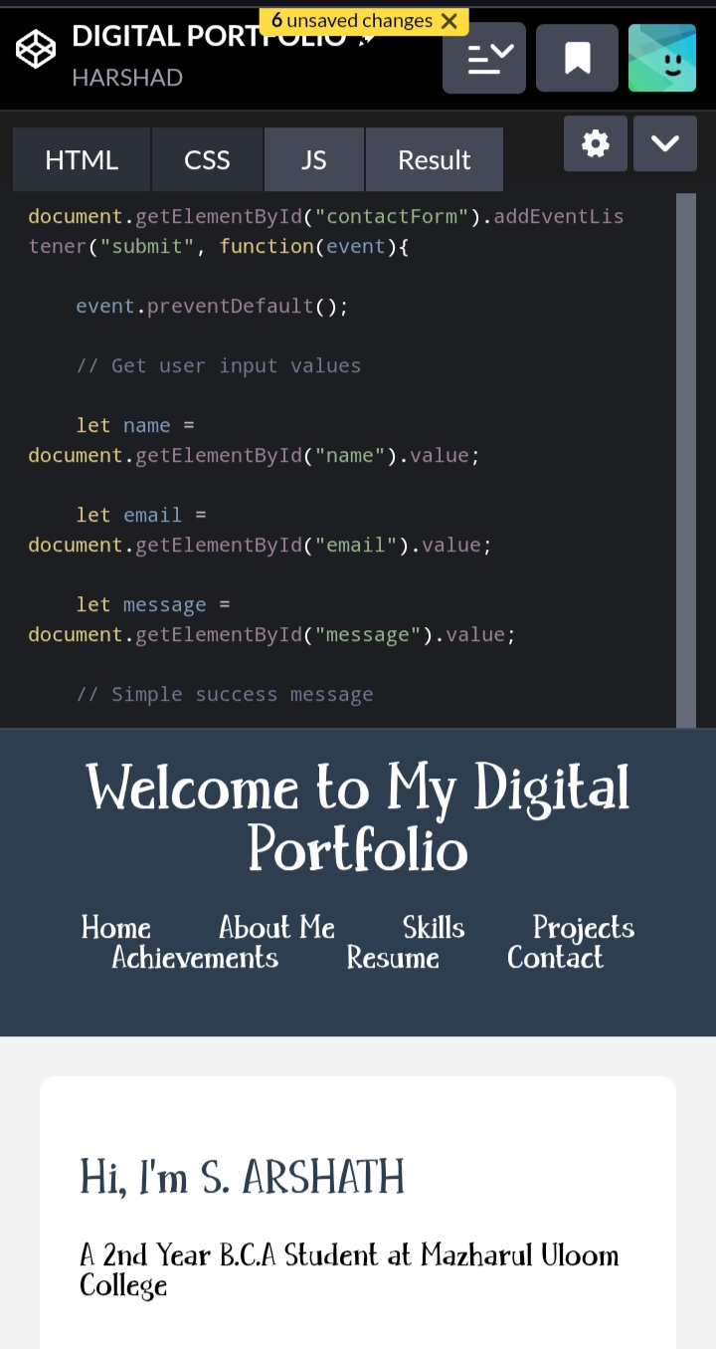
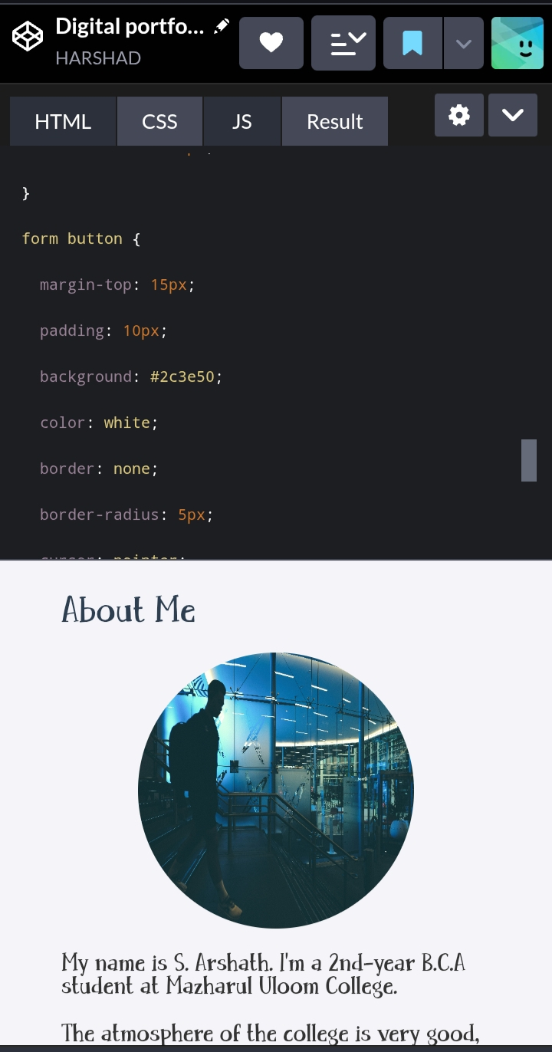

RESULTS AND SCREENSHOTS
1. Displays the project’s final output clearly.
2. Includes relevant screenshots for proof.
3. Shows correct and expected results.
4. Easy to understand and well-organized.
5. Highlights key features visually
3/21/2024 Annual Review
10

Slide 11
CONCLUSION
1. Summarizes key findings or results.
2. Highlights the main purpose achieved.
3. Provides clarity on the outcome.
4. Suggests future scope or improvements.
5. Ends with a clear closing statement
11

